Slide 1
MASTERS IN PROJECT MANAGEMENT
PROJECT RISK
MANAGEMENT
Class: MS(PM)-2(A,B&C)

Slide 2
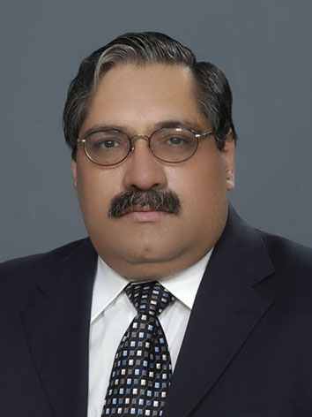
Instructor
Suhail Iqbal
PE, PMP, PgMP, PME, MCT, PRINCE2 Practitioner.
PE, PMP, PgMP, PME, MCT, PRINCE2 Practitioner.
Notes:
Custom animation effects: horizontal scrolling text
(Basic)
To reproduce the text effects on this slide, do the following:
On the Home tab, in the Slides group, click Layout, and then click Blank.
On the Insert tab, in the Text group, click Text Box, and then on the slide, drag to draw the text box.
Enter text in the text box. (Note: You may want to add a bullet point at the end of your text, as in the example above. On the Insert tab, in the Text group, click Symbol. In the Symbol dialog box, in the Font list, select (normal text). In the Subset list, select General Punctuation. In the Character Code box, enter 2022 to select BULLET, and then click Insert.)
Select the text. On the Home tab, in the Font group, do the following:
In the Font list, select Gill Sans MT.
In the Font Size list, select 36.
Click Bold.
Click the arrow next to Font Color, and then under Theme Colors click White, Background 1 (first row, first option from the left).
On the Home tab, in the Paragraph group, click Align Text Left to align the text left in the text box. (Note: If the text wraps to more than one line, drag the adjustment handles on the text box to widen it until the text fits on one line.)
Drag the text box to the left of the lower left edge of the slide. (Note: To see beyond the edges of the slide, on the View tab, click Zoom, and then in the Zoom dialog box, in the Percent box, enter 40%.)
To reproduce the animation effects on this slide, do the following:
On the Animations tab, in the Animations group, click Custom Animation.
On the slide, select the text box. In the Custom Animation task pane, do the following:
Click Add Effect, point to Entrance, and then click More Effects. In the Add Entrance Effect dialog box, under Basic, click Fly In.
Select the animation effect (fly-in effect for the text box). Click the arrow to the right of the select effect, and then click Effect Options. In the Fly In dialog box, do the following:
On the Effect tab, in the Direction list, select From Right.
On the Timing tab, do the following:
In the Start list, select With Previous.
In the Speed box, enter 16 seconds.
In the Repeat list, select Until End of Slide.
On the slide, select the text box. On the Home tab, in the Clipboard group, click the arrow under Paste, and then click Duplicate.
In the Custom Animation task pane, select the second animation effect (fly-in effect for the second text box). Click the arrow to the right of the selected effect, and then click Timing. In the Fly In dialog box, on the Timing tab, in the Delay box, enter 8. (Note: You may need to adjust the delay time if the length of your text is different than the example above.)
On the slide, drag the second text box on top of the first text box.
On the Home tab, in the Editing group, click Select, and then click Selection Pane.
In the Selection and Visibility pane, press and hold CTRL, and then select both text boxes. On the Home tab, in the Drawing group, click Arrange, point to Align, and then do the following:
Click Align Selected Objects.
Click Align Middle.
Click Align Center.
To reproduce the background effects on this slide, do the following:
Right-click the slide background area, and then click Format Background. In the Format Background dialog box, click Fill in the left pane, and then select Picture or texture fill in the Fill pane. Under Insert from, click File. In the Insert Picture dialog box, select a picture, and then click Insert.
On the Home tab, in the Drawing group, click Shapes, and then under Rectangles click Rectangle (first option from the left). On the slide, drag to draw a rectangle.
Select the rectangle. Under Drawing Tools, on the Format tab, in the Size group, do the following:
In the Shape Height box, enter 7.5”.
In the Shape Width box, enter 1”.
Under Drawing Tools, on the Format tab, in the Shape Styles group, click the arrow next to Shape Outline, and then click No Outline.
On the Home Tab, in the Drawing group, click the arrow next to Shape Fill, point to Gradient, and then click More Gradients. In the Format Shape dialog box, click Fill in the left pane, select Gradient fill in the Fill pane, and then do the following:
In the Type list, select Linear.
Click the button next to Direction, and then click Linear Right (first row, fourth option from the left).
Under Gradient stops, click Add or Remove until two stops appear in the drop-down list.
Also under Gradient stops, customize the gradient stops that you added as follows:
Select Stop 1 from the list, and then do the following:
In the Stop position box, enter 0%.
Click the button next to Color, and then under Theme Colors click Black, Text 1 (first row, second option from the left).
In the Transparency box, enter 0%.
Select Stop 2 from the list, and then do the following:
In the Stop position box, enter 100%.
Click the button next to Color, and then under Theme Colors click Black, Text 1, (first row, second option from the left).
In the Transparency box, enter 100%.
On the slide, select the rectangle. On the Home tab, in the Drawing group, click Arrange, point to Align, and then do the following:
Click Align to Slide.
Click Align Left.
Click Align Middle.
Select the rectangle. On the Home tab, in the Clipboard group, click the arrow under Paste, and then click Duplicate.
Select the duplicate rectangle. On the Home Tab, in the Drawing group, click the arrow next to Shape Fill, point to Gradient, and then click Linear Left (second row, third option from the left).
With the duplicate rectangle still selected, on the Home tab, in the Drawing group, click Arrange, point to Align, and then do the following:
Click Align to Slide.
Click Align Right.
Click Align Middle.

Slide 3
SYLLABUS
Unit | Content | Learning Objectives
10. Monitor and Control Risks | Purpose and Objective of the Monitor and Control Risks Process Critical Success Factors for the Monitor and Control Risks Process Tools & Techniques for the Monitor and Control Risks Process Documenting the Results of the Monitor and Control Risks Process | Understand how to Monitor and Control the planned responses and keep an eye on any new risks.

Slide 4
UNIT 11
UNIT 11
MONITOR AND CONTROL RISKS
PROJECT RISK
MANAGEMENT
Class: MS(PM)-2 (A,B&C)

Slide 5
MONITOR AND CONTROL RISKS
LEARNING OBJECTIVE
UNIT 11
Understand how to Monitor and Control the planned responses and keep an eye on any new risks.

Slide 6
MONITOR AND CONTROL RISKS
CONTENT
UNIT 11
Purpose and Objective of the Monitor and Control Risks Process
Critical Success Factors for the Monitor and Control Risks Process
Tools & Techniques for the Monitor and Control Risks Process
Documenting the Results of the Monitor and Control Risks Process

Slide 7
UNIT 11
MONITOR AND CONTROL RISKS
Purpose and Objectives

Slide 8
MONITOR AND CONTROL RISKS
Introduction
UNIT 11
The effectiveness of Project Risk management depends upon the way the approved plans are carried out.
These plans should be executed correctly, reviewed, and updated regularly.
If this is carried out correctly, the invested effort will be rewarded and future projects will benefit from this project’s experience.
From Practice Standard for Project Risk Management, 1st Ed, PMI

Slide 9
MONITOR AND CONTROL RISKS
Purpose and Objectives
UNIT 11
The primary objectives of risk monitoring and controlling are to
track identified risks,
monitor residual risks,
identify new risks,
ensure that risk response plans are executed at the appropriate time, and
evaluate their effectiveness throughout the project life cycle.
In addition to tracking and managing the risk responses, the effectiveness of all of the Project Risk Management processes should be reviewed to provide improvements to the management of the current project as well as future ones.
From Practice Standard for Project Risk Management, 1st Ed, PMI

Slide 10
MONITOR AND CONTROL RISKS
Purpose and Objectives
UNIT 11
For each risk or set of risks for which a contingent response has been defined, the corresponding set of trigger conditions should have been specified.
It is the responsibility of the action owner to ensure that these conditions are effectively monitored and that the corresponding actions are carried out as defined, in a timely manner.
From Practice Standard for Project Risk Management, 1st Ed, PMI

Slide 11
MONITOR AND CONTROL RISKS
Purpose and Objectives
UNIT 11
Once the Plan Risk responses process is complete, all of the approved unconditional response actions should have been included and defined in the current project management plan.
The first action of risk monitoring and controlling is to check whether this is the case and take any appropriate action if necessary, such as invoking the change management process with respect to any missing actions.
This will ensure that the agreed-upon actions are carried out within the normal project execution framework.
From Practice Standard for Project Risk Management, 1st Ed, PMI

Slide 12
MONITOR AND CONTROL RISKS
Purpose and Objectives
UNIT 11
The risk owners and the risk action owners need to be briefed on any changes that may affect their responsibilities.
Effective communication needs to be maintained between them and the project manager so that
the designated stakeholders accept accountability for controlling the potential outcomes of specific risks,
apply their best efforts to track the associated trigger conditions and
carry out the agreed-upon responses in a timely manner.
From Practice Standard for Project Risk Management, 1st Ed, PMI

Slide 13
MONITOR AND CONTROL RISKS
Purpose and Objectives
UNIT 11
In addition to the response actions and trigger conditions, a mechanism for measuring the effectiveness of the response is provided by the Plan Risk Responses process.
The risk action owner should keep the risk owner aware of the status of the response actions so that the risk owner can decide
when the risk has been effectively dealt with, or
whether additional actions need to be planned and implemented.
From Practice Standard for Project Risk Management, 1st Ed, PMI

Slide 14
MONITOR AND CONTROL RISKS
Purpose and Objectives
UNIT 11
As the project progresses, additional information becomes available and the management environment may change as some risks occur, whether foreseen or unforeseen, and others become or cease to be relevant.
The planning should therefore be kept current and the project manager should ensure that periodic risk reassessment, including risk identification, analysis, and risk response planning, is repeated at reasonable intervals, or in response to project events – without generating excessive administrative overhead.
From Practice Standard for Project Risk Management, 1st Ed, PMI

Slide 15
MONITOR AND CONTROL RISKS
Purpose and Objectives
UNIT 11
Typical reasons for risk reassessment are:-
Occurrence of a major or unexpected risk,
Need to analyze a complex change request,
Phase-end review,
Project re-planning or major plan elaboration, and
Periodic review to ensure that the information remains current.
From Practice Standard for Project Risk Management, 1st Ed, PMI

Slide 16
MONITOR AND CONTROL RISKS
Purpose and Objectives
UNIT 11
In the event of major organizational changes, risk management planning may need to be revisited prior to reassessing the risks.
In addition to the regular status reviews, periodic audits should be performed to determine strengths and weaknesses in handling risks within the project.
This should entail identifying any barriers to effectiveness or keys to success in risk management, recognition of which could lead to improvements in risk management of the current or future projects.
From Practice Standard for Project Risk Management, 1st Ed, PMI

Slide 17
MONITOR AND CONTROL RISKS
Purpose and Objectives
UNIT 11
At the end of the project, an integrated analysis of the risk management process should be carried out with a focus on long-term process improvements.
This analysis consolidates the findings of the periodic audits to identify lessons that would be applicable in general to a large proportion of the organization’s projects in the future, such as
appropriate levels of resources,
adequate time for the analysis,
use of tools,
level of detail, etc.
From Practice Standard for Project Risk Management, 1st Ed, PMI

Slide 18
MONITOR AND CONTROL RISKS
Purpose and Objectives
UNIT 11
At project closure, the project manager should ensure that a description has been given of the closure of every risk register:
did not occur
occurred and contingency plan invoked
occurred and impact to the project scope (i.e., time, cost and quality).
From Practice Standard for Project Risk Management, 1st Ed, PMI

Slide 19
MONITOR AND CONTROL RISKS
Purpose and Objectives
UNIT 11
The output of the audit of the risk management process should be consolidated with specific information with respect to the project’s experience of risks, and any generally applicable guidelines for the organization should be highlighted and potential actions proposed for applying them.
This can lead to an update to the corresponding organizational process assets.
From Practice Standard for Project Risk Management, 1st Ed, PMI

Slide 20
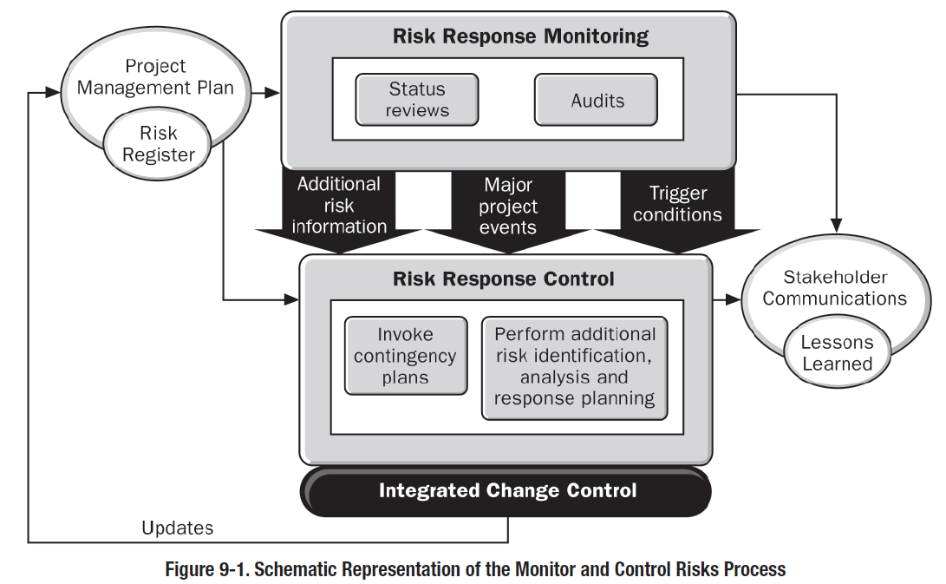
MONITOR AND CONTROL RISKS
Purpose and Objectives
UNIT 11
An overview of the steps involved in the Monitor and Control Risks process is as follows:-
From Practice Standard for Project Risk Management, 1st Ed, PMI

Slide 21
Control Risks

Slide 22
8
4
Monitor and Control Risks
Risk
Monitoring
& Control
Process 11.6
Process of implementing risk response plans, tracking identified risks, monitoring residual risks, identifying new risks, evaluating risk process effectiveness throughout the project.
11.6
Inputs
1
Tools and Techniques
2
Outputs
3
Risk Register
Risk Management Plan
Work Performance Information
Performance Reports
____________
Risk Reassessment
Risk Audits
Variance and Trend Analysis
Technical Performance Measurement
Reserve Analysis
Status Meetings
___________
Risk Register Updates
Organizational Process Assets Updates
Change Requests
Project Management Plan Updates
Project Document Updates
____________
Reference: Figure 11.19.
PMBOK® Guide, 4th Ed
Notes:
Picture with three text columns
(Intermediate)
To reproduce the picture effects on this slide, do the following:
On the Home tab, in the Slides group, click Layout, and then click Blank.
On the Insert tab, in the Illustrations group, click Picture.
In the Insert Picture dialog box, select a picture and then click Insert.
Select the picture. Under Picture Tools, on the Format tab, in the bottom right corner of the Size group, click the Size and Position dialog box launcher.
In the Size and Position dialog box, on the Size tab, resize or crop the picture as needed so that under Size and rotate, the Height box is set to 1.48” and the Width box is set to 9.17”. Resize the picture under Size and rotate by entering values into the Height and Width boxes. Crop the picture under Crop from by entering values into the Left, Right, Top, and Bottom boxes.
On the Home tab, in the bottom right corner of the Drawing group, click the Format Shape dialog box launcher. In the Format Shape dialog box, click Line Color in the left pane, select Gradient line in the right pane, and then do the following:
In the Type list, select Linear.
Click the button next to Direction, and then click Linear Up (second row, second option from the left).
Under Gradient stops, click Add or Remove until two stops appear in the drop-down list.
Also under Gradient stops, customize the gradient stops that you added as follows:
Select Stop 1 from the list, and then do the following:
In the Stop position box, enter 0%.
Click the button next to Color, and then under Theme Colors click White, Background 1 (first row, first option from the left).
Select Stop 2 from the list, and then do the following:
In the Stop position box, enter 100%.
Click the button next to Color, and then under Theme Colors click White, Background 1, Darker 25% (fourth row, first option from the left).
Also in the Format Shape dialog box, click Line Style in the left pane, and then in the right pane, in the Width box, enter 1 pt.
On the Home tab, in the Drawing group, click Shape Effects, point to Glow, and then do the following:
Under Glow Variations, select any option in the first row (5 pt glow options).
Point to More Glow Colors, and then under Theme Colors click White, Background 1, Darker 25% (fourth row, first option from the left).
On the Home tab, in the Drawing group, click Arrange, point to Align, and then click Align Center.
To reproduce the first column heading on this slide, do the following:
On the Home tab, in the Drawing group, click Shapes, and then under Rectangles, click Rectangle (first option from the left). On the slide, drag to draw a rectangle.
Under Drawing Tools, on the Format tab, in the Size group, do the following:
In the Shape Height box, enter 1”.
In the Shape Width box, enter 2.92”.
On the Home tab, in the bottom right corner of the Drawing group, click the Format Shape dialog box launcher. In the Format Shape dialog box, click Fill in the left pane, select Gradient fill in the right pane, and then do the following:
In the Type list, select Linear.
Click the button next to Direction, and then click Linear Down (first row, second option from the left).
Under Gradient stops, click Add or Remove until two stops appear in the drop-down list.
Also under Gradient stops, customize the gradient stops that you added as follows:
Select Stop 1 from the list, and then do the following:
In the Stop position box, enter 32%.
Click the button next to Color, and then under Theme Colors click Tan, Background 2 (first row, third option from the left).
Select Stop 2 from the list, and then do the following:
In the Stop position box, enter 100%.
Click the button next to Color, and then under Theme Colors click Tan, Background 2, Darker 25% (third row, third option from the left).
Also in the Format Shape dialog box, click Line Color in the left pane, select Gradient line in the Line Color pane, and then do the following:
In the Type list, select Linear.
Click the button next to Direction, and then click Linear Up (second row, second option from the left).
Under Gradient stops, click Add or Remove until two stops appear in the drop-down list.
Also under Gradient stops, customize the gradient stops that you added as follows:
Select Stop 1 from the list, and then do the following:
In the Stop position box, enter 0%.
Click the button next to Color, and then under Theme Colors click White, Background 1 (first row, first option from the left).
Select Stop 2 from the list, and then do the following:
In the Stop position box, enter 100%.
Click the button next to Color, and then under Theme Colors click White, Background 1, Darker 25% (fourth row, first option from the left).
Also in the Format Shape dialog box, click Line Style in the left pane. In the right pane, in the Width box, enter 1 pt.
On the Home tab, in the Drawing group, click Shape Effects, point to Glow, and then do the following:
Under Glow Variations, select any option in the first row (5 pt glow options).
Point to More Glow Colors, and then under Theme Colors click White, Background 1, Darker 25% (fourth row, first option from the left).
On the slide, right-click the rectangle and then click Edit Text.
Enter text in the text box and select the text. On the Home tab, in the Font group, select Gill Sans MT from the Font list and then select 24 from the Font Size list.
On the Home tab, in the Paragraph group, click Align Text Left to align the text left within the text box.
Under Drawing Tools, on the Format tab, in the WordArt Styles group, click the arrow next to Text Fill, and then under Theme Colors click Tan, Background 2, Darker 75% (fifth row, third option from the left).
On the Home tab, in the bottom-right corner of the Drawing group, click the Format Shapes dialog box launcher. In the Format Shapes dialog box, click Text Box in the left pane. In the right pane, under Internal margin, enter 1” in the Left box to increase the left margin in the rectangle to accommodate the embossed number.
On the Home tab, in the Drawing group, click Shapes, and then under Lines, click Line (first option from the left).
Press and hold SHIFT, and then on the slide, drag to draw a straight, vertical line.
Under Drawing Tools, on the Format tab, in the Size group, in the Width box, enter 0.75”.
On the Home tab, in the bottom-right corner of the Drawing group, click the Format Shapes dialog box launcher. In the Format Shapes dialog box, click Line Style in the left pane, and then do the following in the right pane:
In the Width box, enter 2.25 pt.
Click the button next to Dash type, and then click Round Dot (second option from the top).
Also in the Format Shapes dialog box, click Line Color in the left pane. In the right pane, click the button next to Color, and then under Theme Colors click White, Background 1 (first row, first option from the left).
On the slide, drag the line onto the rectangle, just left of the text box.
On the Insert tab, in the Text box, click Text Box and then on the slide, drag to draw another text box.
Enter 1 in the text box and select the text. On the Home tab, in the Font group, select Calisto MT from the Font list and then enter 50 in the Font Size box.
On the Home tab, in the Paragraph group, click Center to center the text within the text box.
Under Drawing Tools, on the Format tab, in the WordArt Styles group, click the arrow next to Text Fill, and then under Theme Colors click Tan, Background 2, Darker 25% (third row, third option from the left).
Drag the text box onto the rectangle, left of the dotted vertical line.
On the Home tab, in the Editing group, click Select, and then click Selection Pane.
In the Selection and Visibility pane, press and hold CTRL to select the text box, line, and rectangle.
On the Home tab, in the Drawing group, click Arrange, point to Align, and then click Align Middle.
To reproduce the other column headings on this slide, do the following:
On the Home tab, in the Editing group, click Select, and then click Selection Pane.
In the Selection and Visibility pane, press and hold CTRL to select the text box, line, and rectangle.
On the Home tab, in the Drawing group, click Arrange, and then under Group Objects click Group.
On the Home tab, in the Clipboard group, click the arrow under Paste, and then click Duplicate. Repeat the process until you have a total of three groups of shapes.
Select each group in the Selection and Visibility pane and drag it on the slide to form a row under the picture.
Also in the Selection and Visibility pane, press and hold CTRL and select all three groups. On the Home tab, in the Drawing group, click Arrange, point to Align, and then do the following:
Click Align Middle.
Click Distribute Horizontally.
To change the numbers in the duplicate text boxes (second and third from the left), click in each text box and edit the text.
To reproduce the first column (the “subtext” portion) on this slide, do the following:
On the Home tab, in the Drawing group, click Shapes, and then under Rectangles click Rectangle (first option from the left).
On the slide, drag to draw the rectangle so that the top edge is just below the first column heading and the bottom edge is at the bottom of the slide.
Under Drawing Tools, on the Format tab, in the Size group, in the Shape Width box, enter 2.92” so that the subtext column is the same width as the column heading above it.
On the Home tab, in the Drawing group, click the arrow next to Shape Outline, and then click No Outline.
On the Home tab, in the bottom right corner of the Drawing group, click the Format Shape dialog box launcher. In the Format Shape dialog box, click Fill in the left pane, select Gradient fill in the right pane, and then do the following:
In the Type list, select Linear.
Click the button next to Direction, and then click Linear Down (first row, second option from the left).
Under Gradient stops, click Add or Remove until three stops appear in the drop-down list.
Also under Gradient stops, customize the gradient stops that you added as follows:
Select Stop 1 from the list, and then do the following:
In the Stop position box, enter 0%.
Click the button next to Color, and then under Theme Colors click White, Background 1 (first row, first option from the left).
In the Transparency box, enter 100%.
Select Stop 2 from the list, and then do the following:
In the Stop position box, enter 50%.
Click the button next to Color, and then under Theme Colors click Tan, Background 2, Darker 25% (third row, third option from the left).
In the Transparency box, enter 25%.
Select Stop 3 from the list, and then do the following:
In the Stop position box, enter 100%.
Click the button next to Color, and then under Theme Colors click White, Background 1 (first row, first option from the left).
In the Transparency box, enter 100%.
On the slide, right-click the column and then click Edit Text.
Enter text in the text box and select the text. On the Home tab, in the Font group, select Gill Sans MT from the Font list and then enter 22 in the Font Size box.
On the Home tab, in the Paragraph group, click Center to center the text within the rectangle.
Under Drawing Tools, on the Format tab, in the WordArt Styles group, click the arrow next to Text Fill, and then under Theme Colors click White, Background 1, Darker 50% (sixth row, first option from the left).
On the Home tab, in the bottom-right corner of the Drawing group, click the Format Shapes dialog box launcher. In the Format Shapes dialog box, click Text Box in the left pane. In the right pane, under Text layout, in the Vertical Alignment list, select Top.
To reproduce the other columns (the “subtext” portion) on this slide, do the following:
Select the first “subtext” rectangle. On the Home tab, in the Clipboard group, click the arrow under Paste, and then click Duplicate. Repeat the process until you have a total of three “subtext” rectangles.
Drag each duplicate on the slide to form a row under the “text heading” rectangles.
Press and hold SHIFT and select all three “subtext” rectangles. On the Home tab, in the Drawing group, click Arrange, point to Align, and then click Distribute Horizontally.
To reproduce the background on this slide, do the following:
Right-click the slide background area, and then click Format Background. In the Format Background dialog box, click Fill in the left pane, select Gradient fill in the right pane, and then do the following:
In the Type list, select Radial.
Click the button next to Direction, and then click From Center (third option from the left).
Under Gradient stops, click Add or Remove until two stops appear in the drop-down list.
Also under Gradient stops, customize the gradient stops that you added as follows:
Select Stop 1 from the list, and then do the following:
In the Stop position box, enter 0%.
Click the button next to Color, and then under Theme Colors click White, Background 1 (first row, first option from the left).
Select Stop 2 from the list, and then do the following:
In the Stop position box, enter 100%.
Click the button next to Color, and then under Theme Colors click Tan, Background 2 (first row, third option from the left).

Slide 23
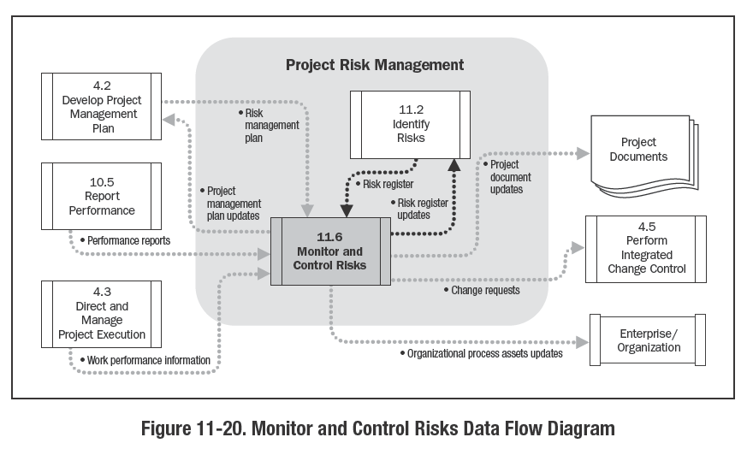
Control Risks
Reference: Figure 11.20.
PMBOK® Guide, 5th Ed

Slide 24
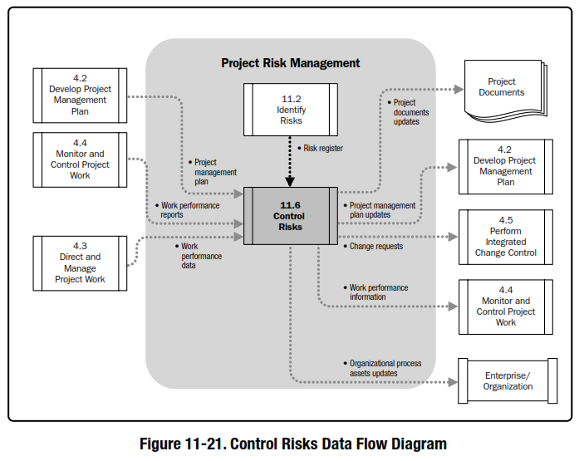
Monitor and Control Risks
Reference: Figure 11.19.
PMBOK® Guide, 4th Ed

Slide 27
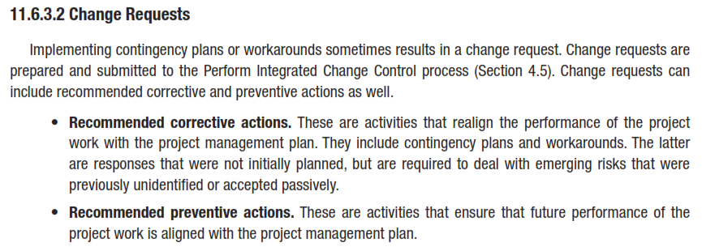

Slide 28
UNIT 11
MONITOR AND CONTROL RISKS
Critical Success Factors

Slide 29
PLAN RISK RESPONSES
Critical Success Factors
UNIT 11
9.2.1 Integrating Risk Monitoring and Control with Project Monitoring and Control
9.2.2 Continuously Monitor Risk Trigger Conditions
9.2.3 Maintain Risk Awareness
From Practice Standard for Project Risk Management, 1st Ed, PMI

Slide 30
MONITOR AND CONTROL RISKS
Critical Success Factors
9.2.1 Integrating Risk Monitoring and Control with Project Monitoring and Control
UNIT 11
From the start, the project management plan should include the actions required to monitor and control project risk.
This should be set up early in the project planning cycle, and then adjusted in view of the risk response planning decisions adding, for example, the actions associated with monitoring specific conditions or metrics.
Once risk response planning has been carried out, the project schedule should include all of the agreed-upon, response-related actions so that they can be carried out as a normal part of project execution and tracked accordingly.
From Practice Standard for Project Risk Management, 1st Ed, PMI
Notes:
ROLE OF PROJECT RISK MGMT
In Corporate Business Management
Two Basic Types in Corporate Business Management:-
Business Risk
Inherent chances of both profit and loss associated with the particular business endeavor.
Business entities employ skilled staff to increase the chances of profit and reduce the chances of loss.
The essential purpose is to maximize profits.
Pure or Insurable Risk
Involves only a chance for loss and no chance for profit.
Insurable risks can be further sub-divided into four categories:-
Direct property loss
Indirect property loss
Liability loss
Personal loss

Slide 31
MONIOR ND CONTROL RISKS
Critical Success Factors
9.2.2 Continuously Monitor Risk Trigger Conditions
UNIT 11
Risk response planning will have defined
a set of actions to be carried out as part of the project schedule as well as
actions whose execution is dependent on a predefined trigger condition.
Checking for specifically defined risks that may trigger conditional responses is the responsibility of the risk action owner, in close collaboration with the risk owner under the overall authority of the project manager.
From Practice Standard for Project Risk Management, 1st Ed, PMI
Notes:
ROLE OF PROJECT RISK MGMT
In Corporate Business Management
Two Basic Types in Corporate Business Management:-
Business Risk
Inherent chances of both profit and loss associated with the particular business endeavor.
Business entities employ skilled staff to increase the chances of profit and reduce the chances of loss.
The essential purpose is to maximize profits.
Pure or Insurable Risk
Involves only a chance for loss and no chance for profit.
Insurable risks can be further sub-divided into four categories:-
Direct property loss
Indirect property loss
Liability loss
Personal loss

Slide 32
MONITOR AND CONTROL RISKS
Critical Success Factors
9.2.3 Maintain Risk Awareness
UNIT 11
Risk management reports should be a register item on every status meeting agenda to ensure that
all team members remain aware of the importance of risk management and
to ensure that is fully integrated into all of the project management decisions.
The project’s senior-level sponsor should require regular reports on the risks and the planned responses to ensure that stakeholders are aware of the importance of keeping a focus on risk.
From Practice Standard for Project Risk Management, 1st Ed, PMI
Notes:
ROLE OF PROJECT RISK MGMT
In Corporate Business Management
Two Basic Types in Corporate Business Management:-
Business Risk
Inherent chances of both profit and loss associated with the particular business endeavor.
Business entities employ skilled staff to increase the chances of profit and reduce the chances of loss.
The essential purpose is to maximize profits.
Pure or Insurable Risk
Involves only a chance for loss and no chance for profit.
Insurable risks can be further sub-divided into four categories:-
Direct property loss
Indirect property loss
Liability loss
Personal loss

Slide 33
MONITOR AND CONTROL RISKS
Critical Success Factors
9.2.3 Maintain Risk Awareness
UNIT 11
Sponsor feedback also motivates the project team by demonstrating senior level interest in Project Risk Management.
Stakeholders perception of the effectiveness of risk management is conditioned in part by the way in which risks are handled as they occur, and by the number of characteristics of such events.
From Practice Standard for Project Risk Management, 1st Ed, PMI
Notes:
ROLE OF PROJECT RISK MGMT
In Corporate Business Management
Two Basic Types in Corporate Business Management:-
Business Risk
Inherent chances of both profit and loss associated with the particular business endeavor.
Business entities employ skilled staff to increase the chances of profit and reduce the chances of loss.
The essential purpose is to maximize profits.
Pure or Insurable Risk
Involves only a chance for loss and no chance for profit.
Insurable risks can be further sub-divided into four categories:-
Direct property loss
Indirect property loss
Liability loss
Personal loss

Slide 34
MONITOR AND CONTROL RISKS
Critical Success Factors
9.2.3 Maintain Risk Awareness
UNIT 11
It is therefore crucial, whenever a risk occurs, that information about the event, as well as the progress and effectiveness of the responses, be communicated at regular intervals and in an honest manner adapted to the needs of each stakeholder.
This should be supported by a well-executed communications plan.
From Practice Standard for Project Risk Management, 1st Ed, PMI
Notes:
ROLE OF PROJECT RISK MGMT
In Corporate Business Management
Two Basic Types in Corporate Business Management:-
Business Risk
Inherent chances of both profit and loss associated with the particular business endeavor.
Business entities employ skilled staff to increase the chances of profit and reduce the chances of loss.
The essential purpose is to maximize profits.
Pure or Insurable Risk
Involves only a chance for loss and no chance for profit.
Insurable risks can be further sub-divided into four categories:-
Direct property loss
Indirect property loss
Liability loss
Personal loss

Slide 35
UNIT 11
MONITOR AND CONTROL RISKS
Tools & Techniques

Slide 36
MONITOR AND CONTRL RISKS
Tools and Techniques
UNIT 11
In addition to standard project management monitoring and control capabilities, risk monitoring and controlling requires a focus on the tools which will support its key success factors for tracking overall risk as well as individual risks.
9.3.1 Managing Contingency Reserves
9.3.2 Tracking Trigger Conditions
9.3.3 Tracking Overall Risk
9.3.4 Tracking Compliance
From Practice Standard for Project Risk Management, 1st Ed, PMI
Notes:
ROLE OF PROJECT RISK MGMT
In Corporate Business Management
Two Basic Types in Corporate Business Management:-
Business Risk
Inherent chances of both profit and loss associated with the particular business endeavor.
Business entities employ skilled staff to increase the chances of profit and reduce the chances of loss.
The essential purpose is to maximize profits.
Pure or Insurable Risk
Involves only a chance for loss and no chance for profit.
Insurable risks can be further sub-divided into four categories:-
Direct property loss
Indirect property loss
Liability loss
Personal loss

Slide 37
MONITOR AND CONTROL RISKS
Tools and Techniques
9.3.1 Managing Contingency Reserves
UNIT 11
Reserves may have been allocated separately to cover time-related and cost-related risks.
Techniques are required that allow the project manager to assess at any point in the project whether these provide the required level of confidence in the success of the project.
Tools for managing time buffers should be closely integrated into the project’s scheduling techniques.
Whereas those for managing cost should be compatible with the financial practices.
Tools are required to identify trends and forecast future outcomes to determine whether the reserves will remain sufficient.
Tools are also required for tracking progress and spending in a consolidated manner.
From Practice Standard for Project Risk Management, 1st Ed, PMI
Notes:
ROLE OF PROJECT RISK MGMT
In Corporate Business Management
Two Basic Types in Corporate Business Management:-
Business Risk
Inherent chances of both profit and loss associated with the particular business endeavor.
Business entities employ skilled staff to increase the chances of profit and reduce the chances of loss.
The essential purpose is to maximize profits.
Pure or Insurable Risk
Involves only a chance for loss and no chance for profit.
Insurable risks can be further sub-divided into four categories:-
Direct property loss
Indirect property loss
Liability loss
Personal loss

Slide 38
MONITOR AND CONTROL RISKS
Tools and Techniques
9.3.2 Tracking Trigger Conditions
UNIT 11
Trigger conditions and the corresponding metrics are defined during the Plan Risk responses process.
Tools are required to evaluate and track these conditions against the project baseline or specified thresholds, based on actual status.
They can be chosen to provide information on risks related to the deliverables, such as performance, as well as on project-related features, such as time and cost.
From Practice Standard for Project Risk Management, 1st Ed, PMI
Notes:
ROLE OF PROJECT RISK MGMT
In Corporate Business Management
Two Basic Types in Corporate Business Management:-
Business Risk
Inherent chances of both profit and loss associated with the particular business endeavor.
Business entities employ skilled staff to increase the chances of profit and reduce the chances of loss.
The essential purpose is to maximize profits.
Pure or Insurable Risk
Involves only a chance for loss and no chance for profit.
Insurable risks can be further sub-divided into four categories:-
Direct property loss
Indirect property loss
Liability loss
Personal loss

Slide 39
MONITOR AND CONTROL RISKS
Tools and Techniques
9.3.3 Tracking Overall Risk
9.3.4 Tracking Compliance
UNIT 11
Tools are required in order to determine, as the project progresses, whether the responses are having the expected effect on the project’s overall level of risk.
In order to monitor the quality of the execution of the risk-related plans and processes, a set of quality metrics such as degree of variation from the baseline, should be tracked and recorded.
These metrics will normally have been defined in the risk management plan.
From Practice Standard for Project Risk Management, 1st Ed, PMI

Slide 40
MONITOR AND CONTROL RISKS
Techniques
UNIT 11
Techniques for Monitor and control Risk are given in Table D below:-
From Practice Standard for Project Risk Management, 1st Ed, PMI

Slide 41
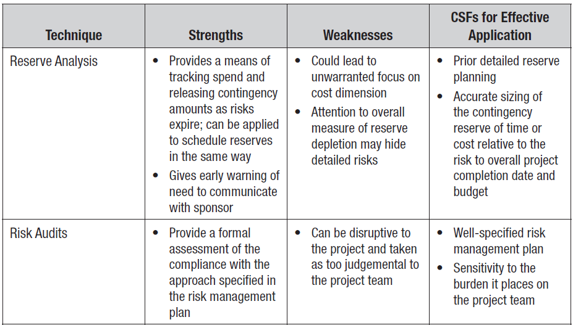
MONITOR AND CONTROL RISKS
Techniques
UNIT 11
From Practice Standard for Project Risk Management, 1st Ed, PMI

Slide 42
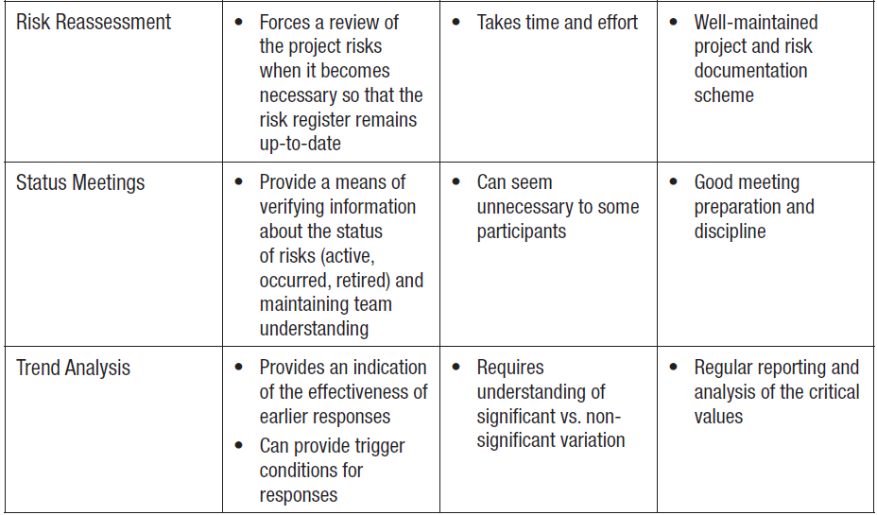
MONITOR AND CONTROL RISKS
Techniques
UNIT 11
From Practice Standard for Project Risk Management, 1st Ed, PMI

Slide 43
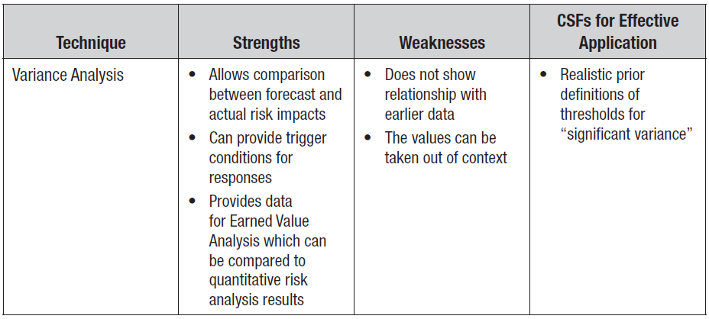
MONITOR AND CONTROL RISKS
Techniques
UNIT 11
From Practice Standard for Project Risk Management, 1st Ed, PMI

Slide 44
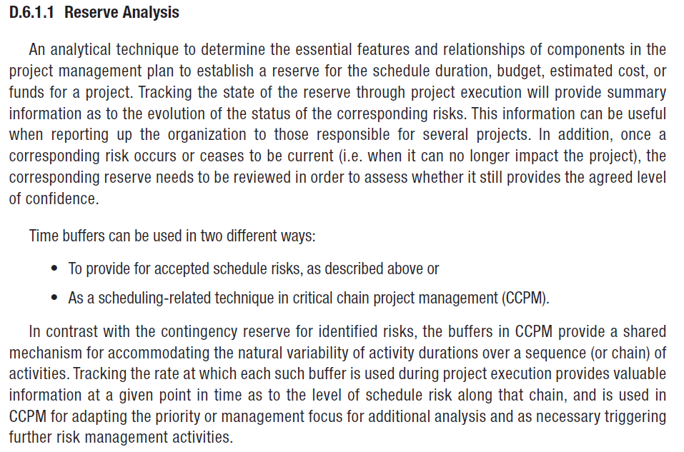
MONITOR AND CONTROL RISKS
Techniques
UNIT 11

Slide 45
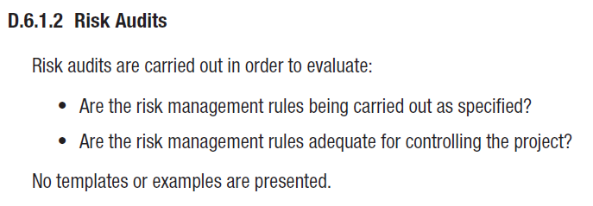
MONITOR AND CONTROL RISKS
Techniques
UNIT 11

Slide 46
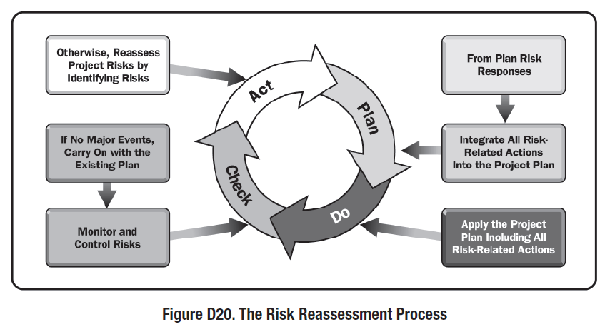
MONITOR AND CONTROL RISKS
Techniques
UNIT 11
From Practice Standard for Project Risk Management, 1st Ed, PMI

Slide 47
MONITOR AND CONTROL RISKS
Techniques
UNIT 11
From Practice Standard for Project Risk Management, 1st Ed, PMI

Slide 48
MONITOR AND CONTROL RISKS
Techniques
UNIT 11
From Practice Standard for Project Risk Management, 1st Ed, PMI

Slide 49
UNIT 11
MONITOR AND CONTROL RISKS
Documenting the Results

Slide 50
MONITOR AND CONTROL RISKS
Documenting the Results
UNIT 11
The final control action of risk monitoring and controlling is to record actual data for future use.
This includes all of the relevant information relating to risk management from start to finish of the project.
The definition of what this information must include, as well as the storage mechanism, should have been previously specified in the risk management plan.
The goal is to ensure that the significant risk management information is recorded to provide concrete data to the lessons learned process for inclusion in a lessons learned document, report, or other communication vehicle.
From Practice Standard for Project Risk Management, 1st Ed, PMI
Notes:
ROLE OF PROJECT RISK MGMT
In Corporate Business Management
Two Basic Types in Corporate Business Management:-
Business Risk
Inherent chances of both profit and loss associated with the particular business endeavor.
Business entities employ skilled staff to increase the chances of profit and reduce the chances of loss.
The essential purpose is to maximize profits.
Pure or Insurable Risk
Involves only a chance for loss and no chance for profit.
Insurable risks can be further sub-divided into four categories:-
Direct property loss
Indirect property loss
Liability loss
Personal loss

Slide 51
MONITOR AND CONTROL RISKS
Documenting the Results
UNIT 11
Typical information includes the following:-
For each identified risk or type of risk,
whether it occurred, and if so, when and how often. All relevant data should be recorded:
impact,
effectiveness of detection and
of response, and
any unplanned,
additional actions that were carried out.
Effectiveness of avoidance or exploitation actions.
Effectiveness of transfer and sharing actions.
Unexpected or undocumented risks which occurred and data about them.
Effectiveness of risk mitigation and enhancement actions.
Occurrence of accepted threats or opportunities.
From Practice Standard for Project Risk Management, 1st Ed, PMI
Notes:
ROLE OF PROJECT RISK MGMT
In Corporate Business Management
Two Basic Types in Corporate Business Management:-
Business Risk
Inherent chances of both profit and loss associated with the particular business endeavor.
Business entities employ skilled staff to increase the chances of profit and reduce the chances of loss.
The essential purpose is to maximize profits.
Pure or Insurable Risk
Involves only a chance for loss and no chance for profit.
Insurable risks can be further sub-divided into four categories:-
Direct property loss
Indirect property loss
Liability loss
Personal loss

Slide 52
MONITOR AND CONTROL RISKS
Documenting the Results
UNIT 11
Consolidated information should be provided on the level of effort expended.
Costs and benefits to the project of risk management activities should also be provided.
This information will need to be archived and indexed in a manner that will facilitate retrieval for easy review
during the project,
at closure, and
for future projects, when the need arises.
From Practice Standard for Project Risk Management, 1st Ed, PMI
Notes:
ROLE OF PROJECT RISK MGMT
In Corporate Business Management
Two Basic Types in Corporate Business Management:-
Business Risk
Inherent chances of both profit and loss associated with the particular business endeavor.
Business entities employ skilled staff to increase the chances of profit and reduce the chances of loss.
The essential purpose is to maximize profits.
Pure or Insurable Risk
Involves only a chance for loss and no chance for profit.
Insurable risks can be further sub-divided into four categories:-
Direct property loss
Indirect property loss
Liability loss
Personal loss

Slide 53
UNIT 11
CHANGE CONTROL SYSTEM

Slide 54
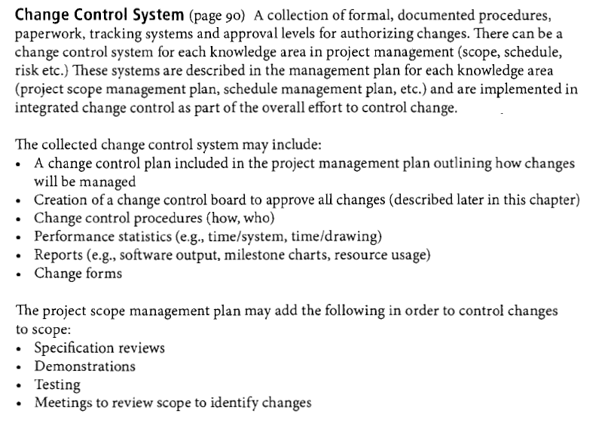
PMP Exam Prep, 5th Ed, Rita Mulcahy, RMC Publications

Slide 55
CHANGE CONTROL
BOARD
UNIT 11

Slide 56
CHANGE CONTROL
Process for Making Changes
UNIT 11
Prevent the root cause of change
Identify change
Create change request
Assess the change
Look at the impact of the change
Perform integrated change control
Look for options
Change is approved or rejected
Adjust the project management plan and baselines
Notify stakeholders affected by the change
Manage the project to the new project management plan
PMP Exam Prep, 5th Ed, Rita Mulcahy, RMC Publications

Slide 57
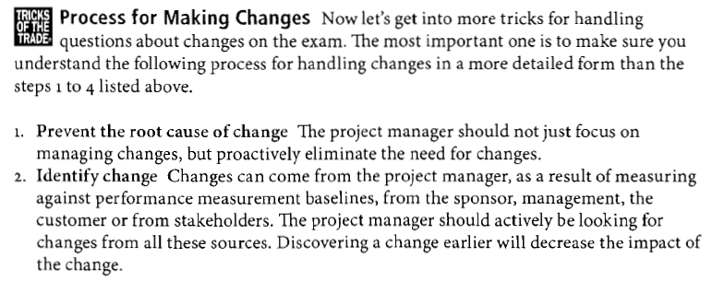
CHANGE CONTROL
Process for Making Changes
UNIT 11
PMP Exam Prep, 5th Ed, Rita Mulcahy, RMC Publications

Slide 58
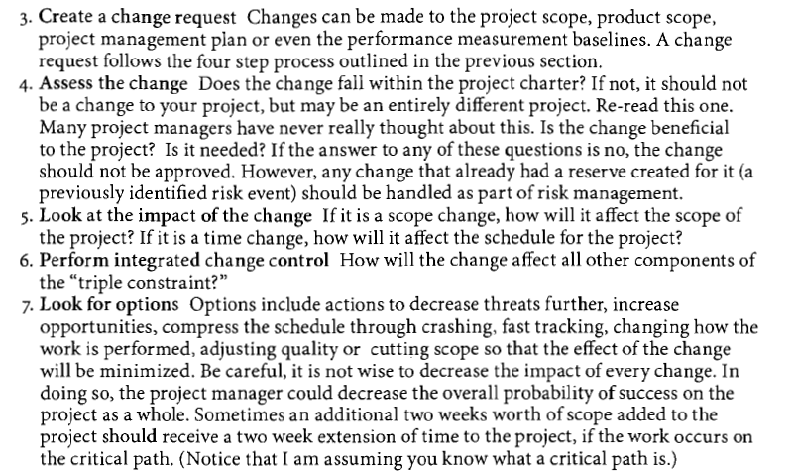
CHANGE CONTROL
Process for Making Changes
UNIT 11

Slide 59
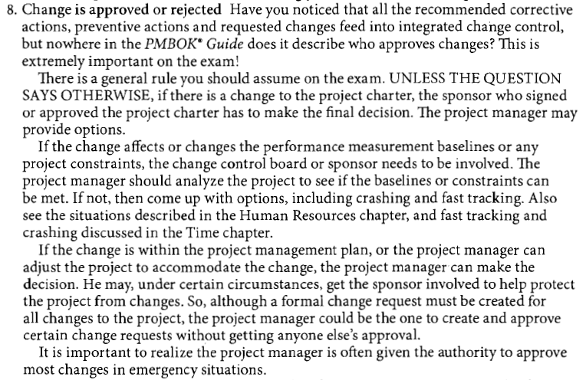
CHANGE CONTROL
Process for Making Changes
UNIT 11

Slide 60
CHANGE CONTROL
Process for Making Changes
UNIT 11
The integrated change control process is listed in the monitoring and controlling process group, but it really occurs during all the project management processes.
For example, various management plans are created in project planning, Integrated change control should be done during project planning to approve or reject requested changes to the planning portion of management plans.
PMP Exam Prep, 5th Ed, Rita Mulcahy, RMC Publications

Slide 61
UNIT 9
Review Questions

Slide 62
The End
THE END
THANK YOU

